Slide 1


AWS S3 Bucket To Microsoft Fabrics Transaction Analytics
By Seun Odeyemi

Slide 2
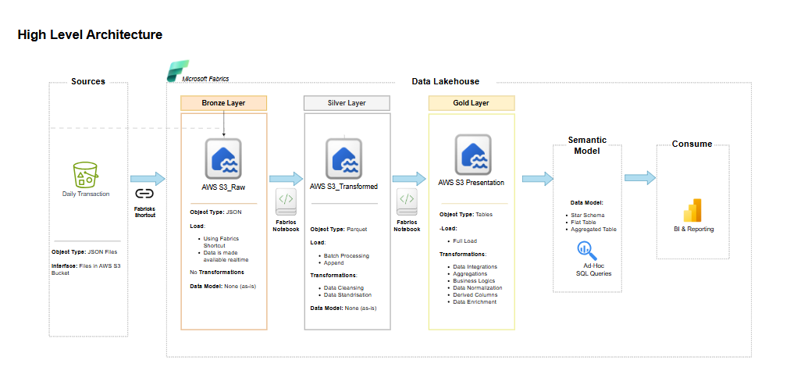
Architecture

Slide 3
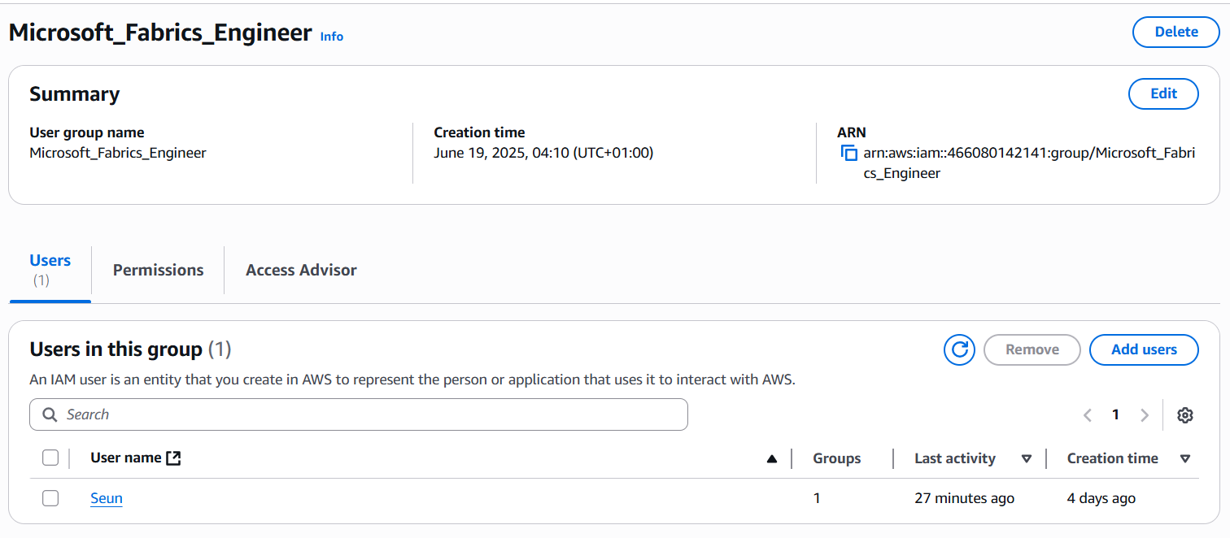
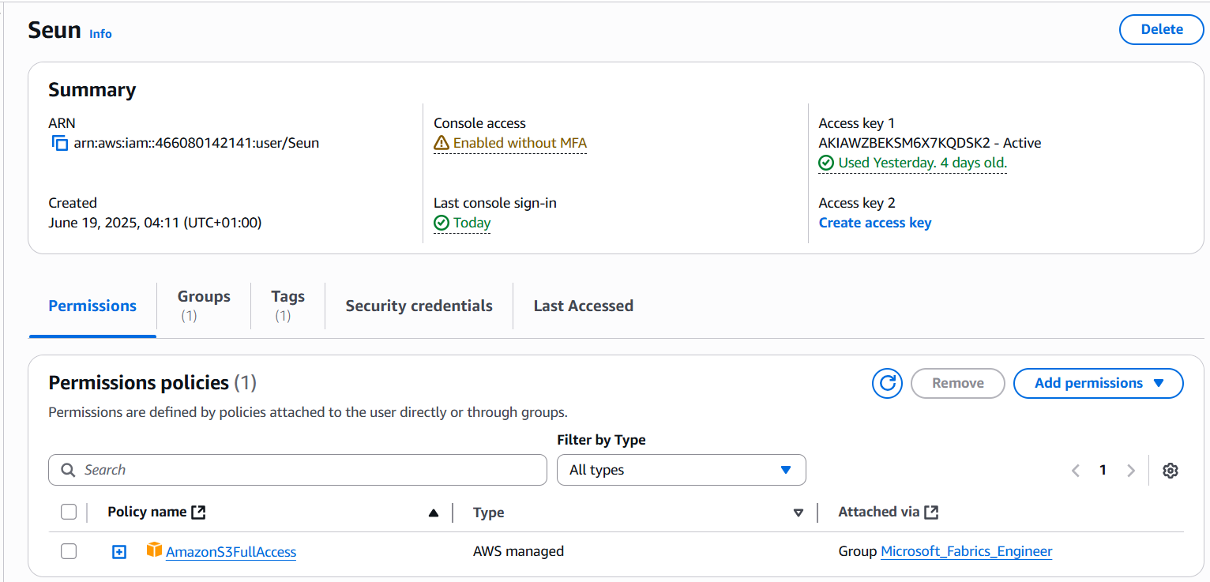
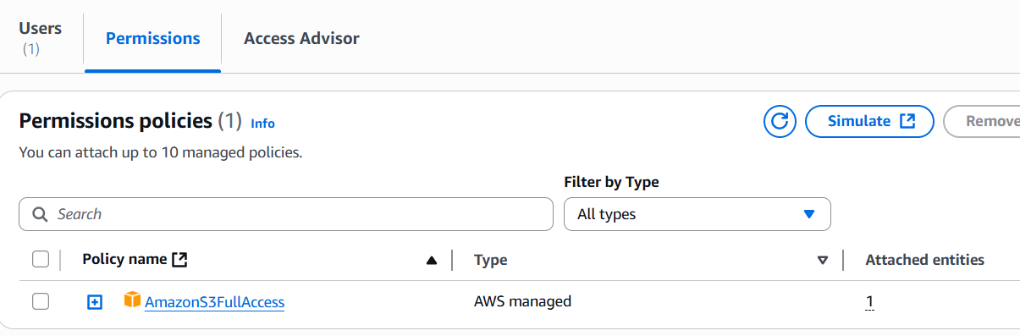
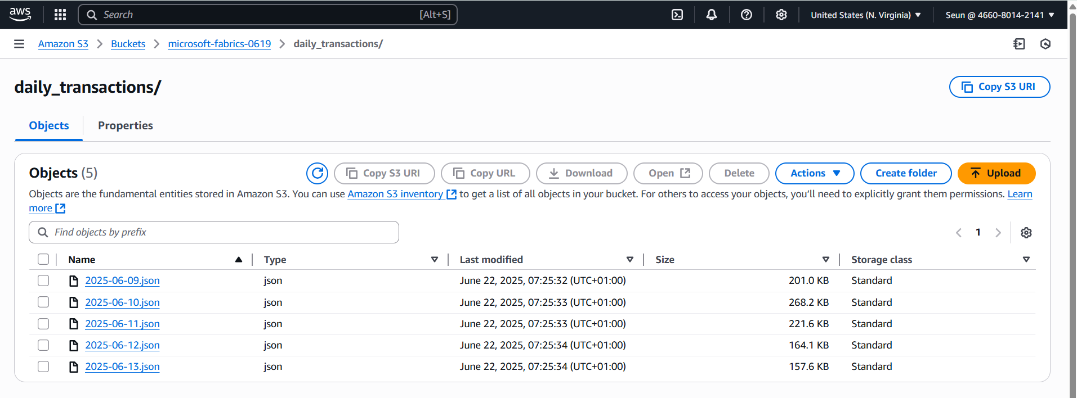
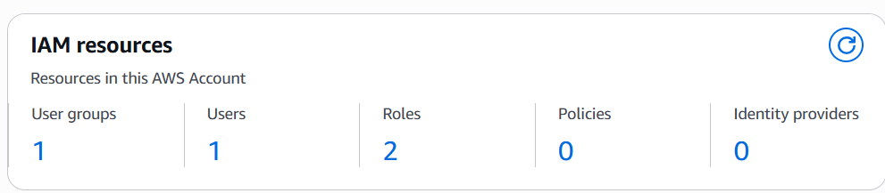
AWS S3
Root User Create User Group and Add A User to the Group
Root User Create Access Key for User
Root User Add Permission to User Group
User Sign in With Credentials and upload files daily

Slide 4
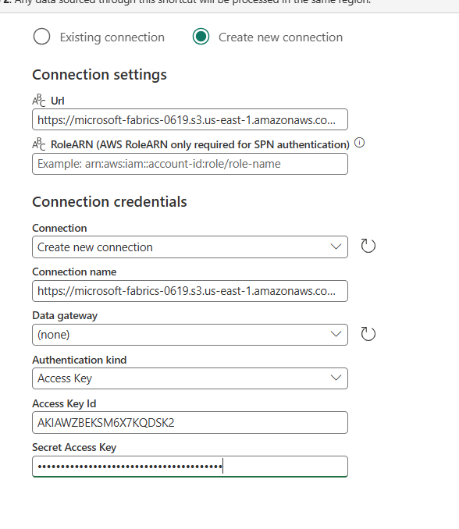
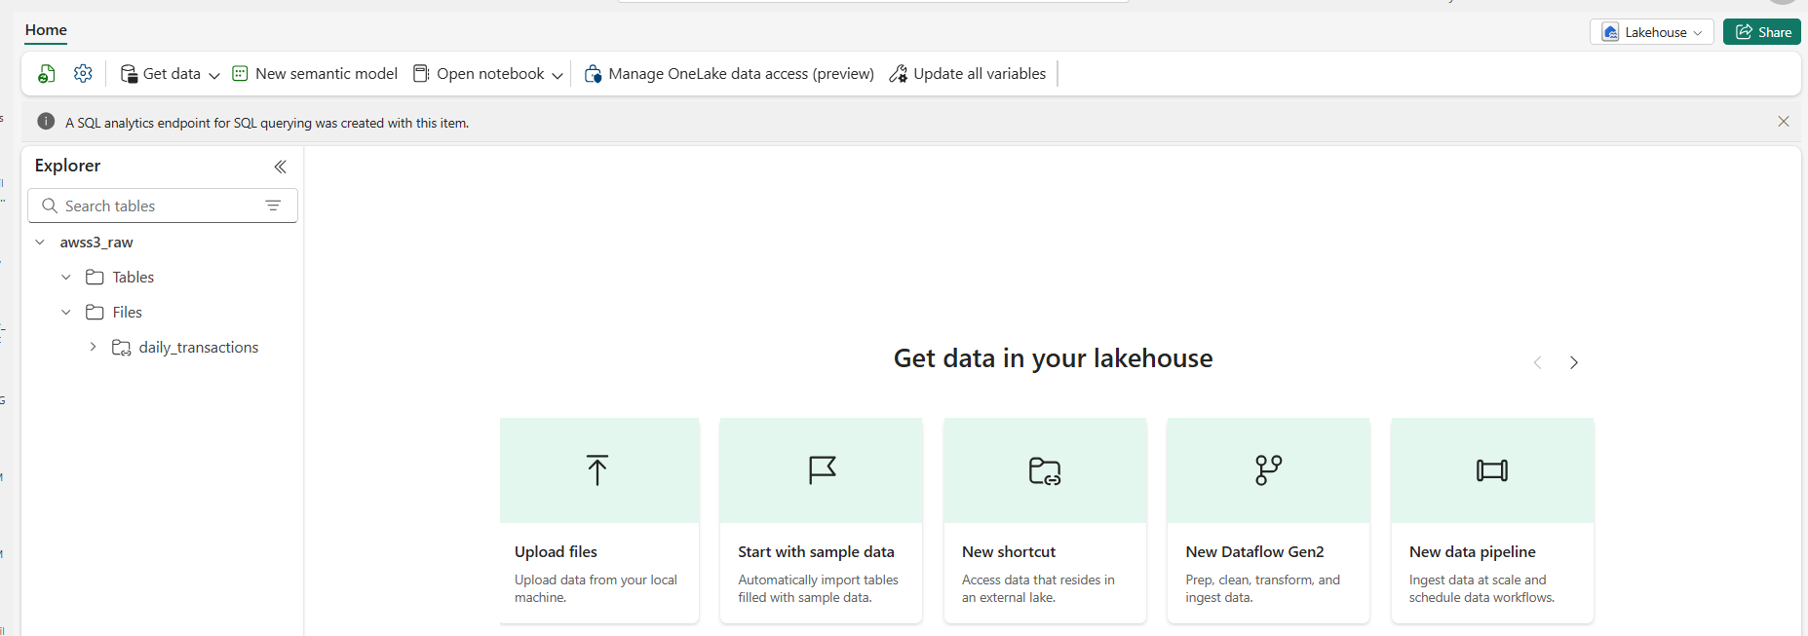
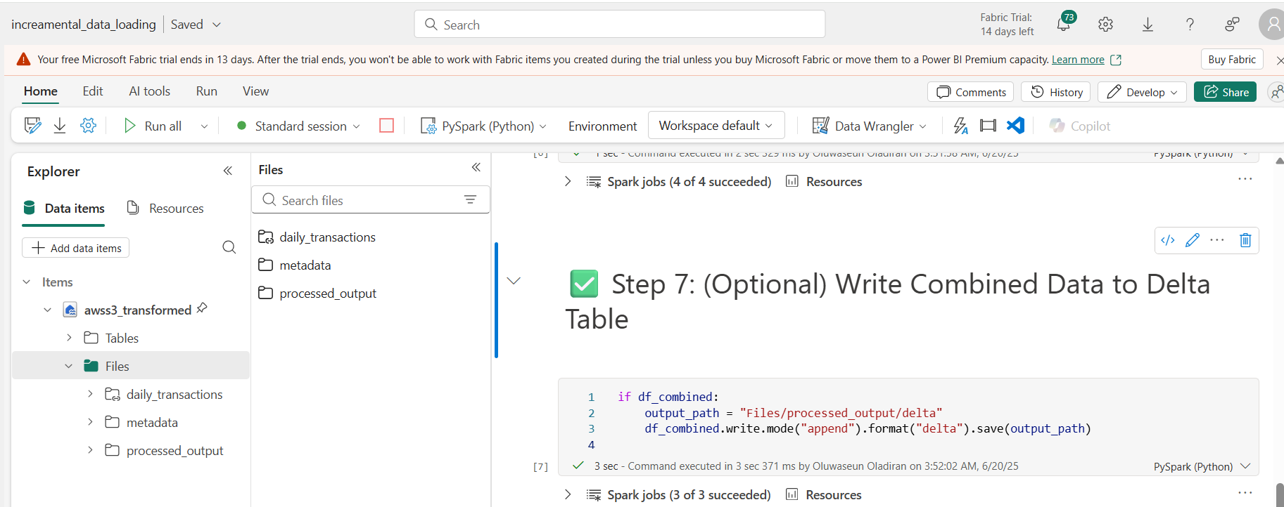
Microsoft Fabrics
Create Project in Microsoft Fabrics and use Medallion predesigned task flow
Raw Lakehouse connection
Raw Lakehouse connection Successful
Incremental load script for Silver layer data loading

Slide 5
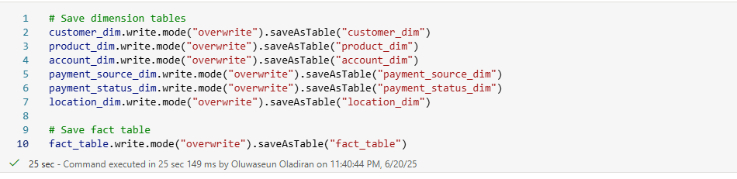
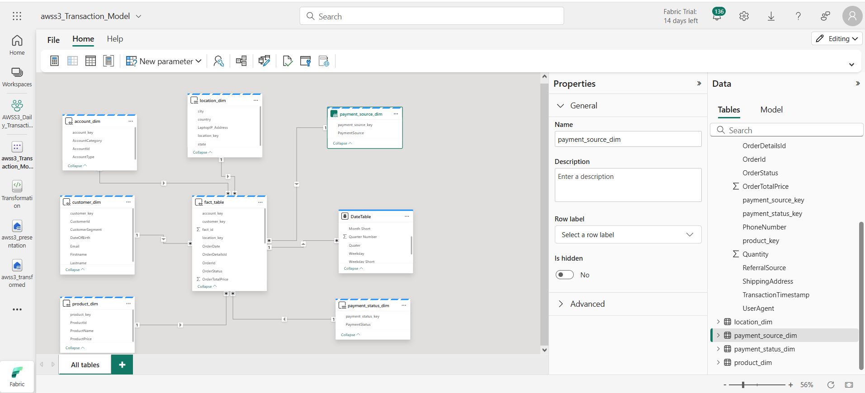
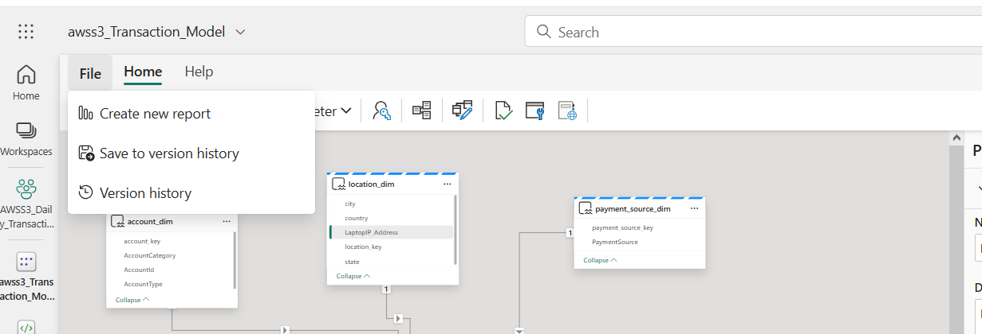
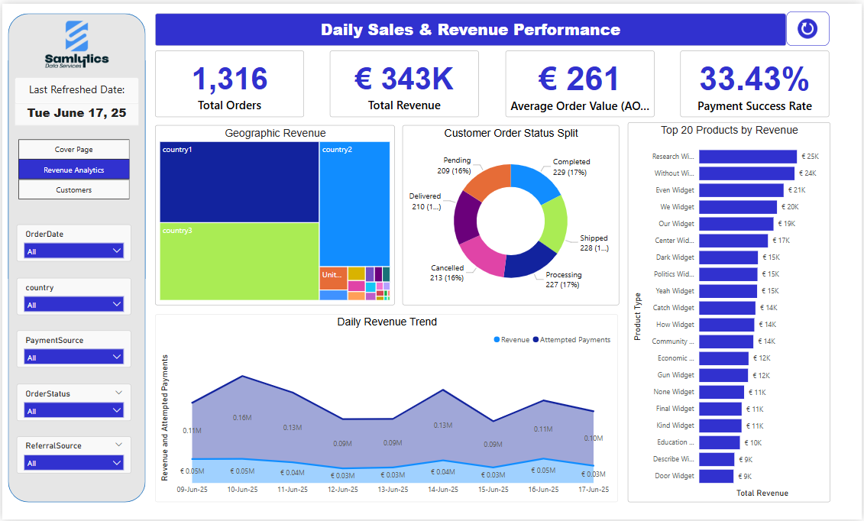
Microsoft Fabrics
Transform data and load as tables in the Gold layer Lakehouse
Create a Semantic Model on the Tables in the Gold Layer
Create New Report on the Semantic Model

Slide 6
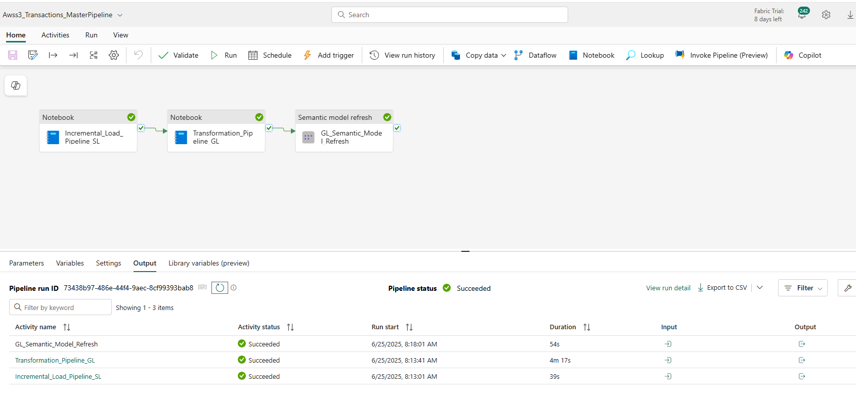
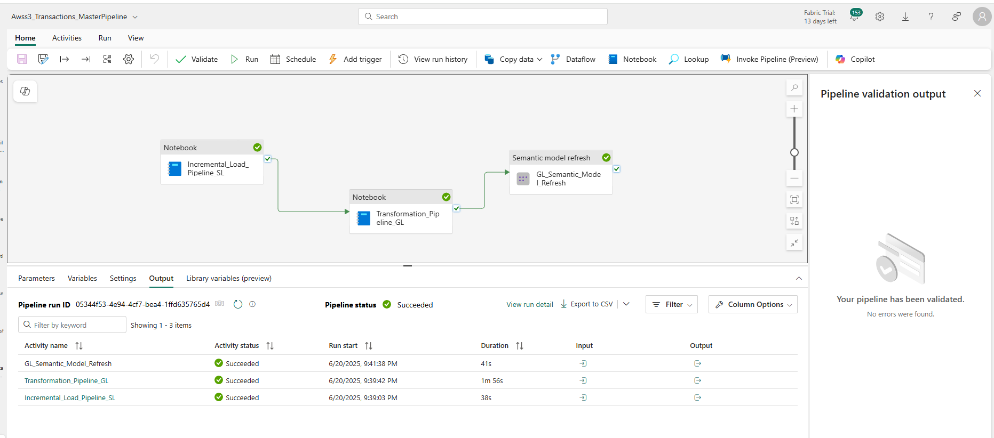
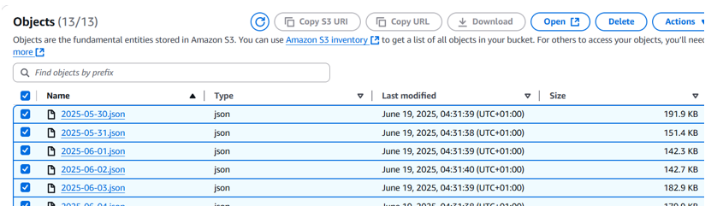
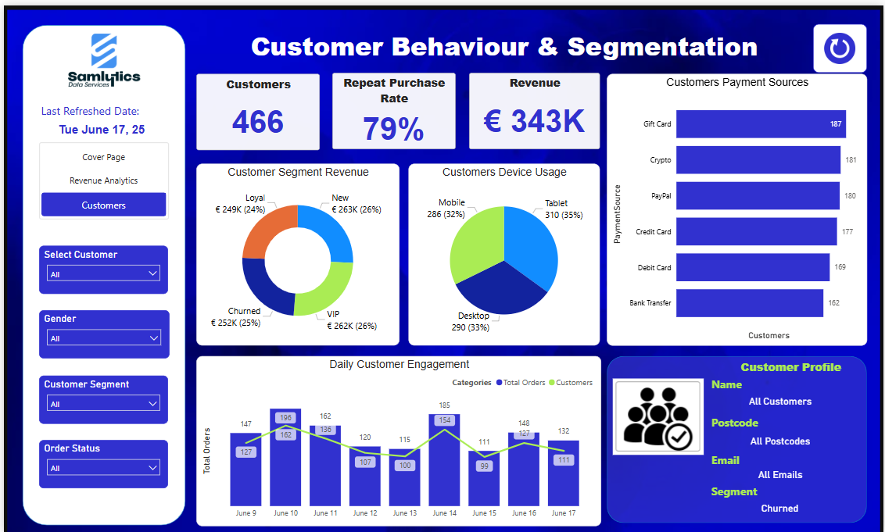
Microsoft Fabrics
Create Master Pipeline to Automate all Touchpoints in Fabrics. Execute to ensure all will be successful
Upload new file in S3 Bucket and run pipeline again
Confirm new transaction date is updated on the report

Slide 7





Thank you
I am Seun Odeyemi a highly accomplished Senior Data Leader with over half a decade of experience driving strategic business transformation through data-driven solutions. My expertise spans data science, analytics, and engineering, with a proven track record in leading complex data migrations, automation, and advanced analytics initiatives. I excel at translating technical insights into actionable business strategies and have successfully built robust, autonomous data systems and pipelines on Microsoft Fabrics (Azure), AWS, and GCP.
I am proficient in various data tools and languages, passionate about leveraging cutting-edge technologies to deliver tangible business improvements. In my free time, I facilitate trainings, engage in insightful conversations, and share projects on GitHub to support other data engineers. I'm always open to discussing how new technologies can help organisations achieve their data aspirations.

